Slide 1
INSTITUTE STAFF’S DATA ANALYSIS USING EXCEL
STUDENT NAME : L. NISHANTHI
REGISTER NO : 122204268
DEPARTMENT : BCOM (CORPORATE SECRETARYSHIP)
COLLEGE : GOVT ARTS AND SCIENCE COLLEGE RK, CHENNAI - 81

Slide 2
PROJECT TITLE
INSTITUTE STAFF’S DATA ANALYSIS USING EXCEL

Slide 3

AGENDA
Problem Statement
Project Overview
End Users
Our Solution and Proposition
Dataset Description
Modelling Approach
Results and Discussion
Conclusion

Slide 4
PROBLEM STATEMENT
These data’s can be used to analyse various aspects of
College Staff, such as
Diversity and representation
Staff retention and turnover
Professional development and growth
Student satisfaction and outcomes
Departmental or institutional
Remember to ensure data privacy and confidentiality when working with staff data

Slide 5
PROJECT OVERVIEW
Institute Staff Data Analysis mean analysing the data of the staff by considering various factors like gender, age, job, salary status, department, location and their job role it also the staffs data and patterns of different attributes of staff data’s.

Slide 6

WHO ARE THE END USERS?
Teachers
Students
Organisation
College administration
Principal and Head Masters
Education policy makers

Slide 7
OUR SOLUTION AND ITS VALUE PROPOSITION
Conditional Formatting – missing
Filter – remove
Formula – salary status
Graph – data visualization

Slide 8
DATASET DESCRIPTION
College staff
19 – features
10- features
Emp name – text
Emp age – num
Gender – male, female
Department – text
Job status
Sick leave - num
Location
Job role
Salary – num

Slide 9
THE "WOW" IN OUR SOLUTION
=IFS(I2>=40000,"VERY HIGH",I2>=30000,"HIGH",I2>=20000,"MEDIUM")
3/21/2024 Annual Review
9

Slide 10
MODELLING
DATA COLLECTION
Download the data in the EDUNET website
Ready to work project
Features collection
Identify staff salary status
Identify priority
DATA CLEANING
Identify the missing value
Filter the missing value
Calculate salary status
10

Slide 11
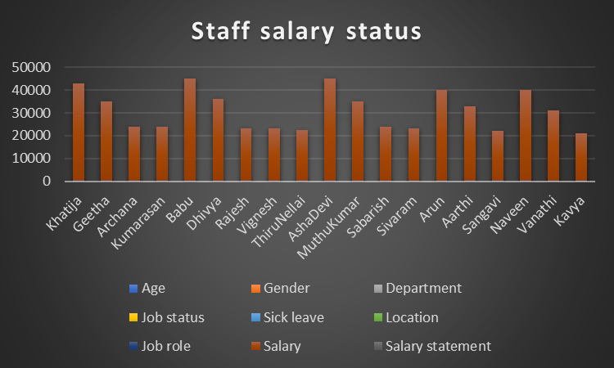
RESULTS
11

Slide 12
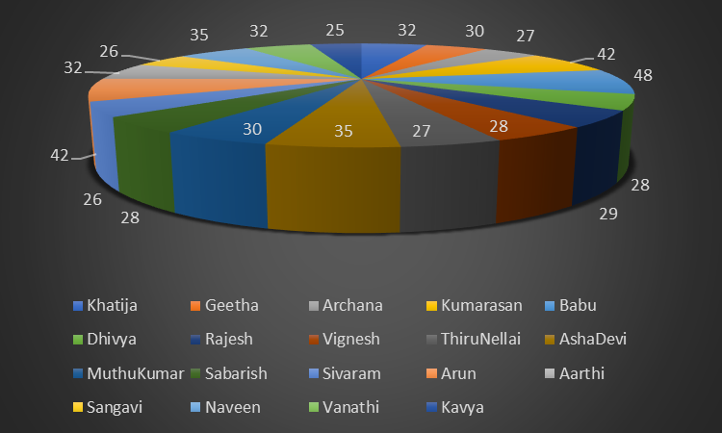
PIE CHART

Slide 13
CONCLUSION
Staff Data’s analysis for Age and Gender: The workforce is predominantly young, with an average age of 30 something, and there is a balanced gender representation in most roles, except for technical roles which are male-dominated. Salary Insights: Average salaries are competitive, but there is a noticeable gap between genders in managerial roles, which warrants further review. Location Impact: Employees in urban locations tend to earn higher salaries, correlating with higher living costs. Attendance Patterns: High attendance rates are linked with roles that offer performance bonuses, indicating a positive impact of financial incentives on attendance.

Slide 14
THANK YOU

